Slide 1


Understanding ML, Generative AI, LLMs, and Agentic AI
- An In-Depth Research and Insight Presentation
By: Anjali Punsi
Date : 15 January 2025

Slide 2

Introduction to Artificial Intelligence (AI)
The terms AI refer to machines that perform tasks requiring human intelligence, which include visual perception, speech recognition, decision-making, and translation of language.
Types of AI:
1. Narrow AI: Siri or Google Assistant.
2. General AI: Hypothetical AI that can perform any intellectual task that a human can.
AI is revolutionizing various industries, including healthcare, finance, manufacturing, and entertainment.

Slide 3

What is Generative AI ?
Generative AI refers to AI models capable of generating new content, such as images, text, audio, and video, based on patterns learned from data.
Techniques:
1. Generative Adversarial Networks (GANs): A framework where two neural networks (generator and discriminator) compete to generate realistic data.
2. Variational Autoencoders (VAEs): Used to generate new, similar data by learning an efficient representation of input data.
Examples: AI-generated images, synthetic music, text-based content (e.g., GPT-3).

Slide 4
History and Evolution of Generative AI
Initial AI development of rule-based and early machine-learning systems.
Transformer-based models emerge that revolutionize natural language processing (NLP).
2014
2020 - Future
1950 -1990
2015-2019
Ian Goodfellow introduced GANs, which was a breakthrough in generative modeling.
Increasing sophistication of models like GPT-3, DALL-E, and other large-scale generative models.

Slide 5




01
Manipulation and Abuse: AI-generated content is used for manipulating or deceiving people, like deepfakes.
Ethical Considerations in Generative AI
Intellectual Property:
Who owns AI-generated content? The creator of the AI, or the AI itself?
02
03
Regulation: Legal infrastructure in place as guidance for use in ethical use of generative AI.
04
Privacy: LLMs trained on large datasets leak sensitive information.

Slide 6




Challenges in Generative AI
Bias and Fairness
Models can learn biased patterns from the training data, which may result in unfair or discriminatory outputs.
Ethical Concerns
Manipulation of media (deepfakes), misinformation
Data Privacy
Generative AI models often require massive datasets, raising concerns about privacy.

Slide 7
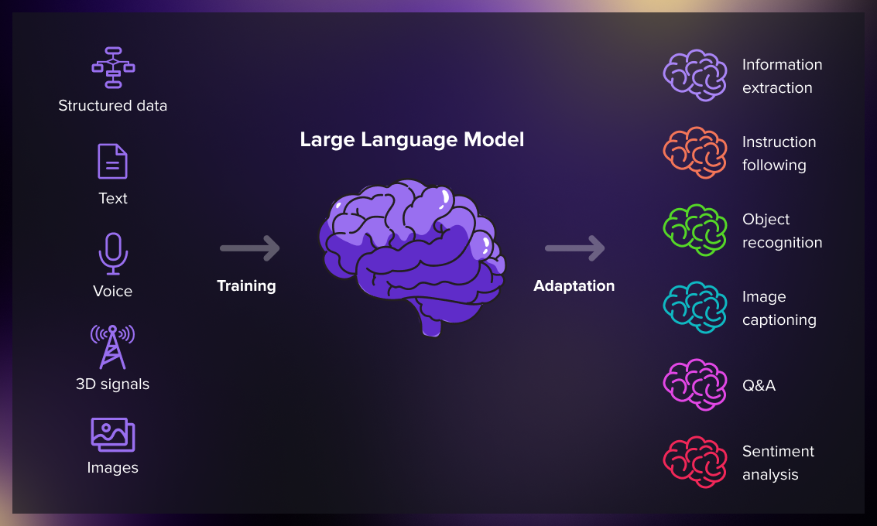
What Are Large Language Models (LLMs) ?
LLMs are AI models intended to understand, generate, and translate human language through the processing of large volumes of text data.
Key Features:
1. Ability to recognize context and generate coherent text.
2. Trained on large corpora (millions or billions of words).
3. Pre-trained and fine-tuned on specific tasks such as sentiment analysis, translation, summarization, etc.

Slide 8
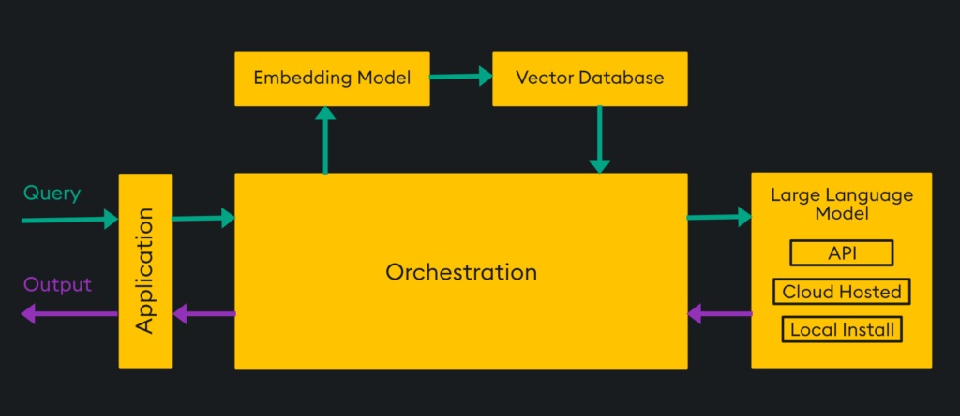
How do LLms Work?

Slide 9
How do LLms Work?
Transformer-Based LLM Architecture
Input Layer : Words/sub-words are tokenized and turned into embeddings.
Embedding Layer : Words converted to vector representations carrying meaning.
Transformer Layers:
1. Multiples of layers containing Self-Attention to extract relationship between words
2. Feedforward Neural Networks (FFNs) take the embeddings through feedforward transformations to refine.
Output Layer: These embeddings are decoded as human-readable text, like for example next-word prediction.
Pre-Training & Fine-Tuning: The former is on the large datasets while latter is task-oriented.
Retrieval-Augmented Generation (RAG): Leverage on Vector Databases to retrieve from external knowledge.

Slide 10


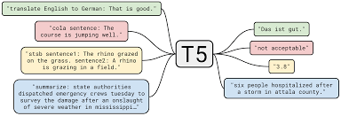
Popular Large Language Models
GPT-3 (Generative Pre-trained Transformer):
1. Developed by OpenAI.
2. Can generate human-like text, answer questions, summarize content, and more.
BERT (Bidirectional Encoder Representations from Transformers):
1. Developed by Google.
2. Mainly used for question answering and sentiment analysis.
T5 (Text-to-Text Transfer Transformer):
1. Another transformer-based model by Google that treats all NLP tasks as text-to-text problems.

Slide 11




Ethical Concerns in LLMs
Misinformation
Privacy
Responsibility
LLMs can create seemingly plausible but false content.
Privacy: LLMs trained on big data may end up leaking some sensitive information.
Who is liable for the deleterious outputs produced by LLMs?

Slide 12
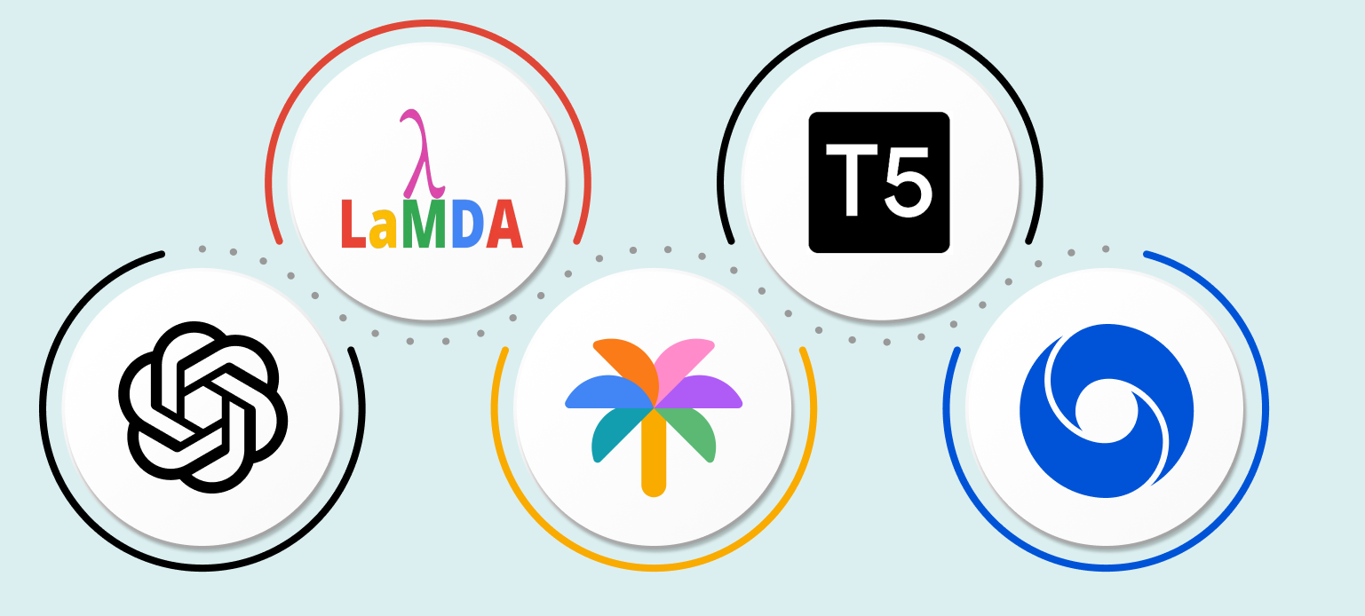
Applications of LLMs
Text Generation: Chatbots, Automated Content Generation, and Creative Writing.
Translation: Language translation (e.g., Google Translate).
Sentiment Analysis: Customer feedback or social media analysis.
Text Summarization:
Shortening long papers
into brief overviews.
Examples: GPT-3,
Google's BERT,
among many others.

Slide 13

Challenges in LLMs
Biases in Training Data
LLM can inherit biases present in the data used for training.
Limited Context
LLMs can not comprehend or remember much context in conversation or documents.
Energy Consumption
Training LLMs demands a lot of computational power and, therefore, consumes much energy.

Slide 14
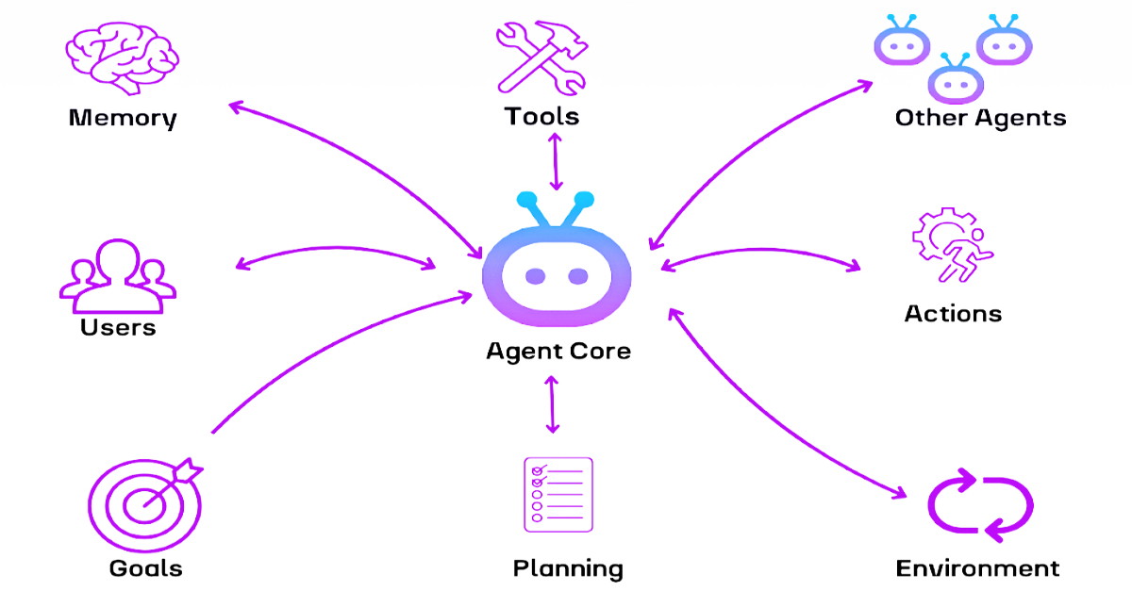
Introduction to Agentic AI
Agentic AI refers to AI systems that are designed to act autonomously to achieve specific objectives or goals, often involving decision-making and learning capabilities.
Key Features:
Autonomy: Capacity to decide and act
on their own.
Self-Learning: The ability to improve
and adapt over time.
Ethical Decision-Making: The ability to make decisions based on ethical frameworks.

Slide 15
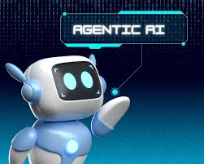
Features of Agentic AI
Autonomy: Performs functions with minimal human intervention, like self-driving cars.
Self-Learning: It keeps on learning with feedback and new data.
Ethical Frameworks: Involves decision-making mechanisms considering ethics and societal norms.
Example: Driverless car determining the pace, route, and other impediments.

Slide 16
Applications of Agentic AI
Robotics
Autonomous Vehicles
Personal Assistants
healthcare

Slide 17



Challenges in Agentic AI
Accountability
Models can learn biased patterns from the training data, which may result in unfair or discriminatory outputs.
Ethical Dilemmas
Manipulation of media (deepfakes), misinformation
Transparency
Generative AI models often require massive datasets, raising concerns about privacy.

Slide 18

Case Study 1 - Agentic AI in Autonomous Vehicles
Examples of Self-Driving Cars: Tesla, Waymo, and other autonomous systems.
Pros:
Reduced accidents through precision and lack of human error.
Increased mobility for individuals unable to drive.
Cons:
Ethical dilemmas in decision-making (e.g., accident scenarios).
Safety risks due to hacking or system failure.

Slide 19

Role of Data in LLMs and Agentic AI
Importance of Data:-
Large datasets allow for robust training of LLMs.
Diverse data reduces biases and improves
generalization
Challenges:
Data privacy concerns.
Managing the quality and accuracy of datasets

Slide 20
Comparison table
Sr no | Generative AI | LLMs | Agentic AI
Definition | AI systems that generate new content, such as text, images, or music, based on patterns in training data. | A category of generative AI trained on massive text datasets to understand and generate natural language. | AI systems that can make decisions and act on their own without human intervention.
Algorithms | Generative Adversarial Networks (GANs), Variational Autoencoders (VAEs), Transformers | Transformer architectures, Fine-tuning | Planning Algorithms, Reinforcement algorithms
Data Usage | Uses big, diverse datasets (text, images, audio) for training models to produce realistic outputs. | Processes massive text datasets to learn language patterns, using billions of tokens for pre-training and task-specific fine-tuning. | Leverages real-time, dynamic datasets (e.g., IoT, sensory data) for autonomous decision-making, with a focus on data quality and relevance.

Slide 21
Goal | Content creation | Process and generate languages | To perform tasks
Focus | Creativity | Language processing | Decision making
Purpose | Creativity and human-like outputs. | Language processing tasks, including translation, summarization, and dialogue generation. | To mimic human-like autonomy for complex tasks.
Examples | ChatGPT, DALL·E, and music composition tools. | GPT-3, GPT-4, BERT | Autonomous vehicles, robotics.

Slide 22
Conclusion
Generative AI and LLMs are revolutionizing industries with the ability to automate content generation, language understanding, and creative tasks.
Agentic AI may act independently for the optimization of processes and decisions.
It includes ethical concerns, bias, and data privacy issues.
Real-world applications showcase how these technologies are enhancing fields like healthcare, finance, and entertainment.
Moving forward, AI should be deployed responsibly by focusing on ongoing innovation and society impact.

Slide 23



THANK YOU!
Anjali Punsi
+91 9579482628
anjalipunsi2@gmail.com
Mumbai,Maharashtra

Slide 24
Resource Page
Template Source: Canva
Information Source: Google Scholar
Images Source: Pexels, Google Images

